Slide 1

Intel Distribution of Python Library

Slide 2
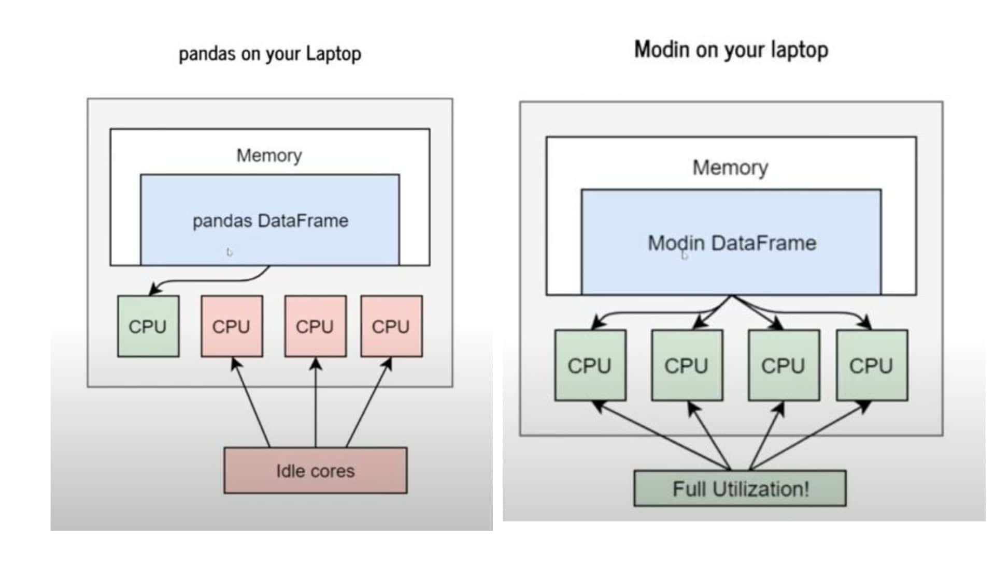
Modin - Pandas

Slide 3
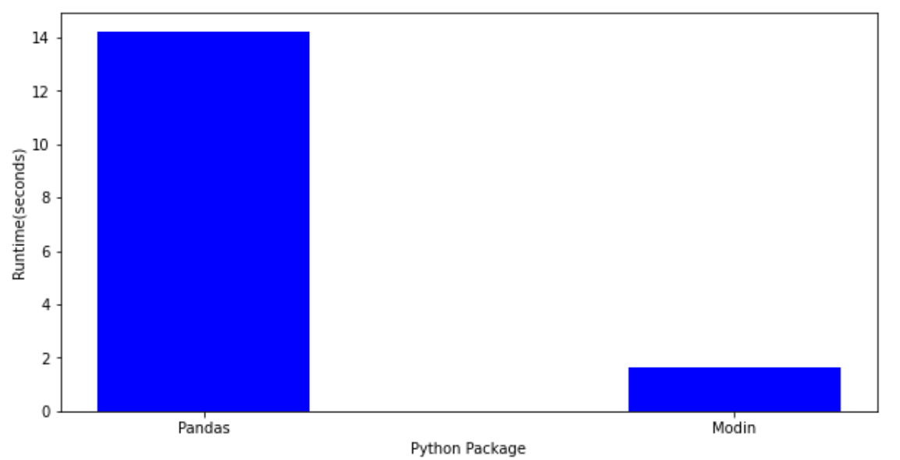
Modin vs Pandas

Slide 4

Please contact
Foundation for Innovation and Collaborative
Education
mentor@fice.in
www.fice.in
Please contact
Foundation for Innovation and Collaborative
Education
info@fice.in
mentor@fice.in
Notes:
Here are the lessons we are going to learn today.

